Slide 1
Project Fake Taxi
Colin Bossuyt, Xander Vyvey, Alberiek Depreytere and Esteban Desmedt
https://github.com/vives-project-xp/Fake-Taxi

Slide 2
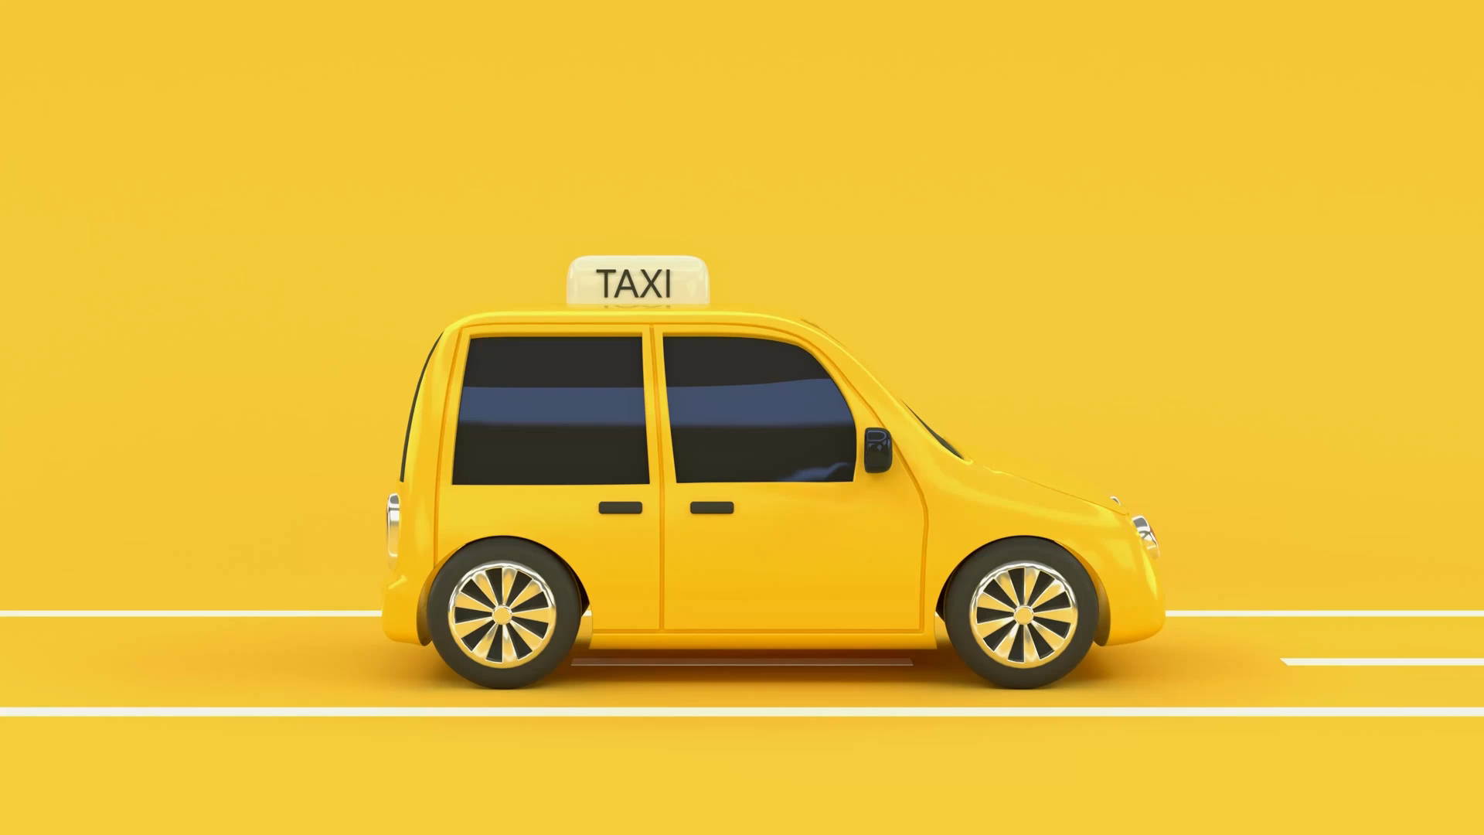
Table of contents
The role of each team member
The problem statement
The proof of concept
Code
The prototype of the product
The planning
Some final thoughts on the project

Slide 3
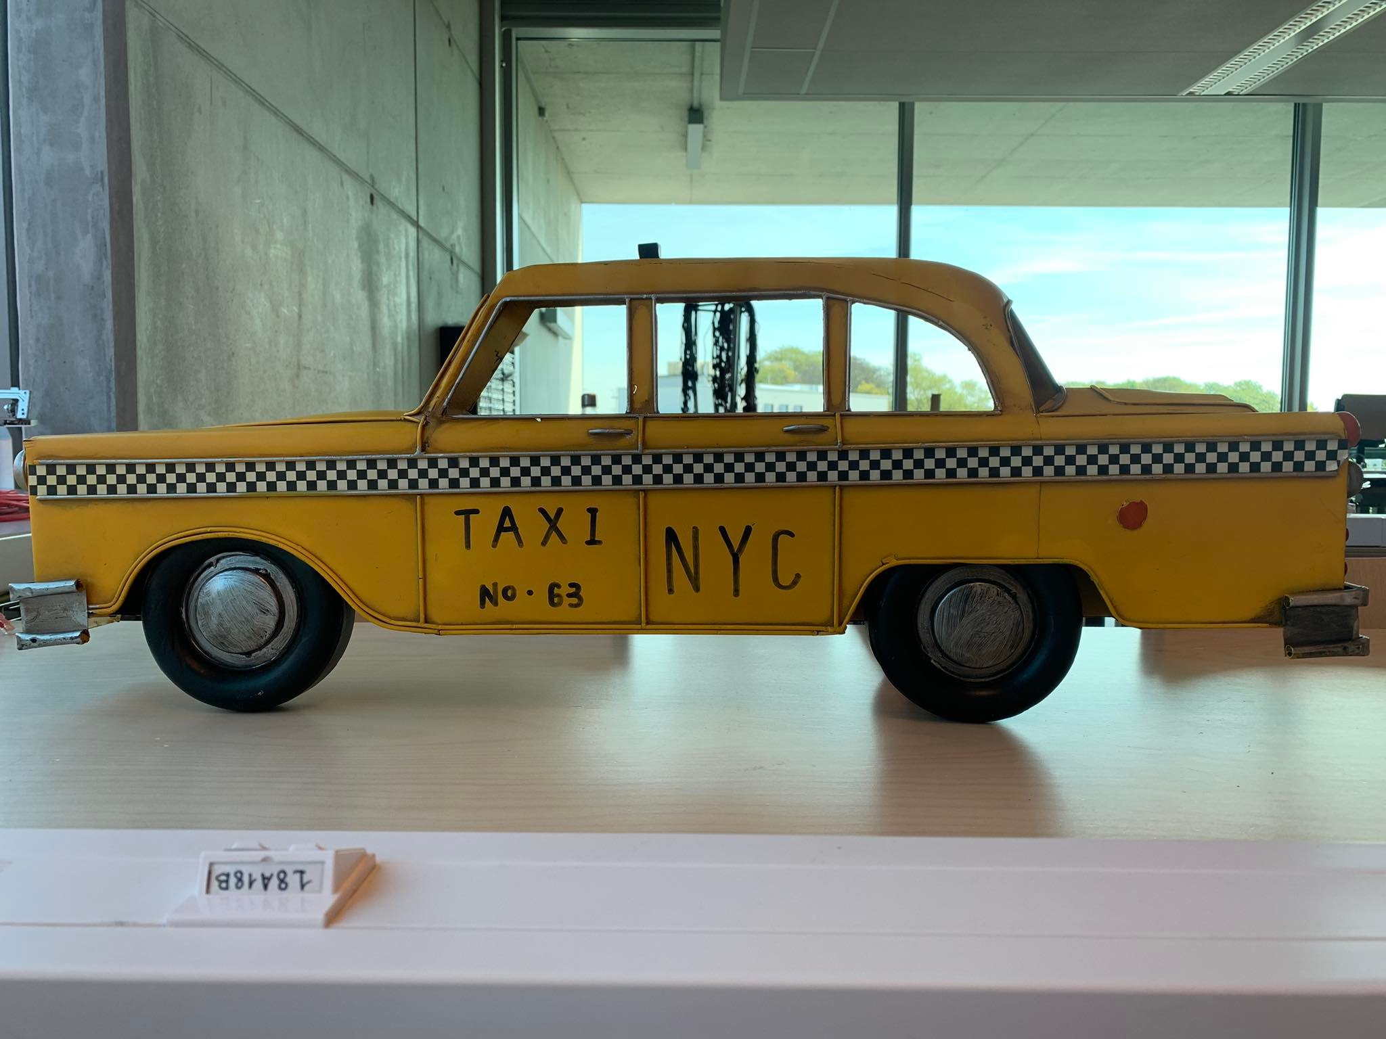
Meet our team

Slide 4
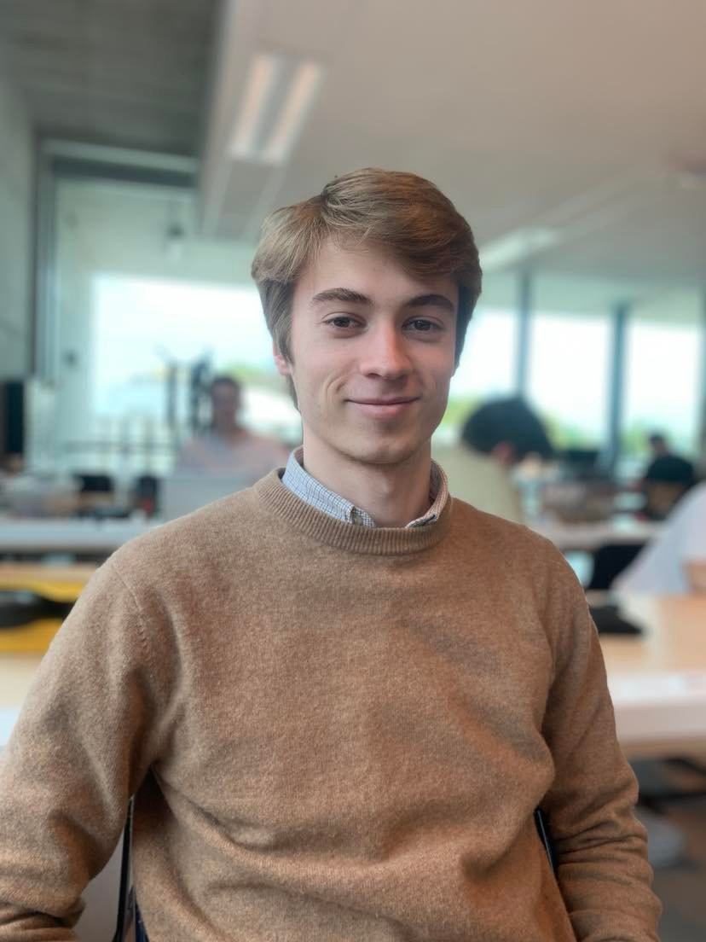
Colin Bossuyt
3D prints
Engine drive
G-code
Arduino IDE

Slide 5
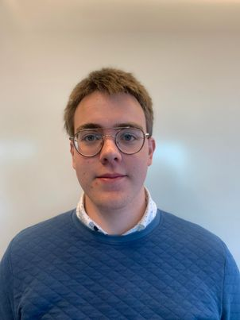
Alberiek Depreytere
Speaker
Elektronica

Slide 6
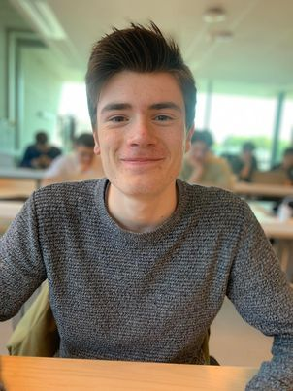
Xander Vyvey
Mechanica
Engine drive
ReadME
Prototype

Slide 7
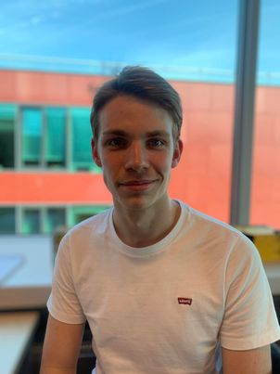
Esteban Desmedt
Software
Engine drive
Documentation
Video

Slide 8



Problem

Slide 9
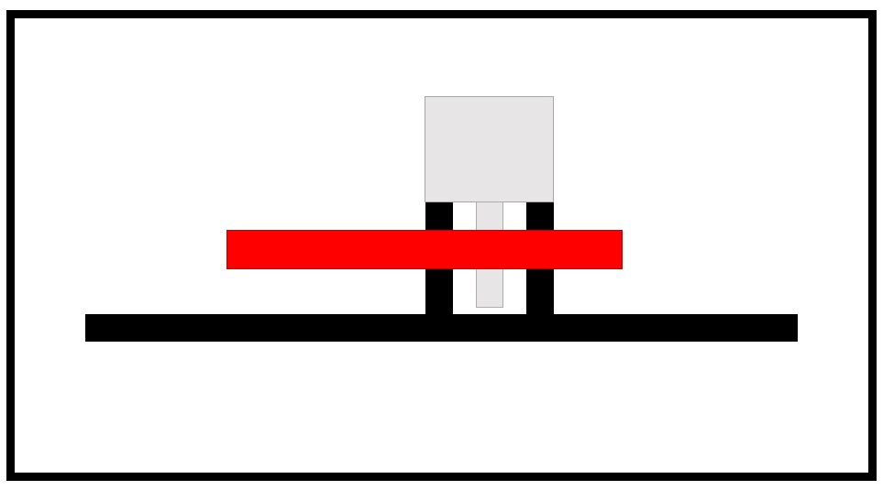
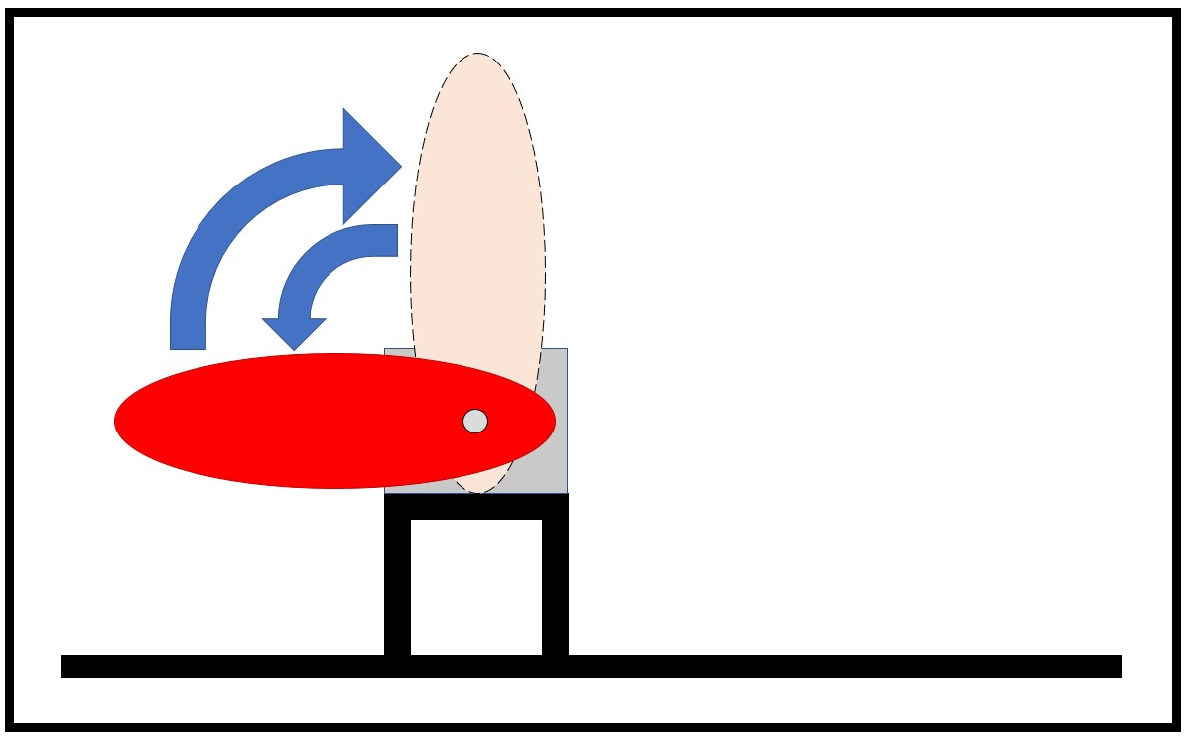
Concept

Slide 10
Code

Slide 11
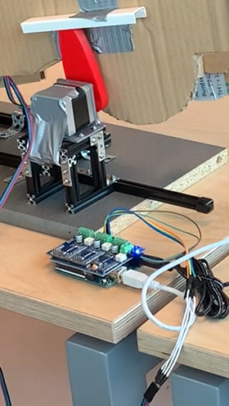
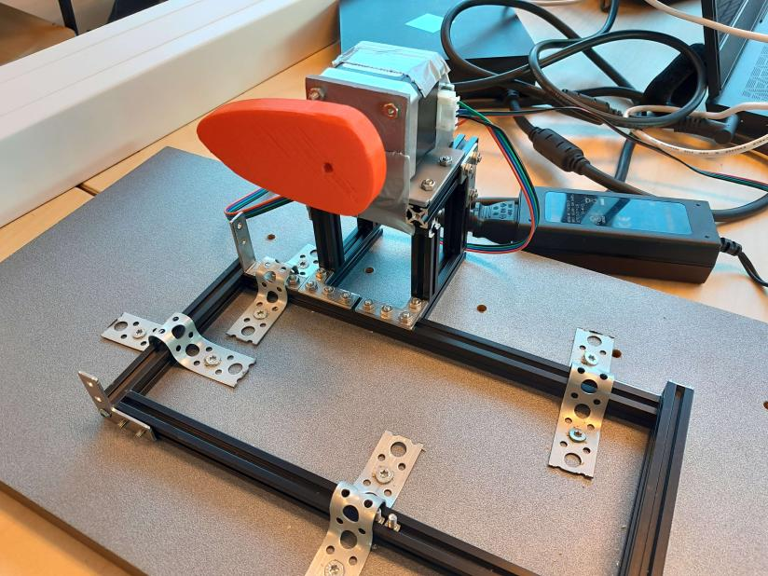
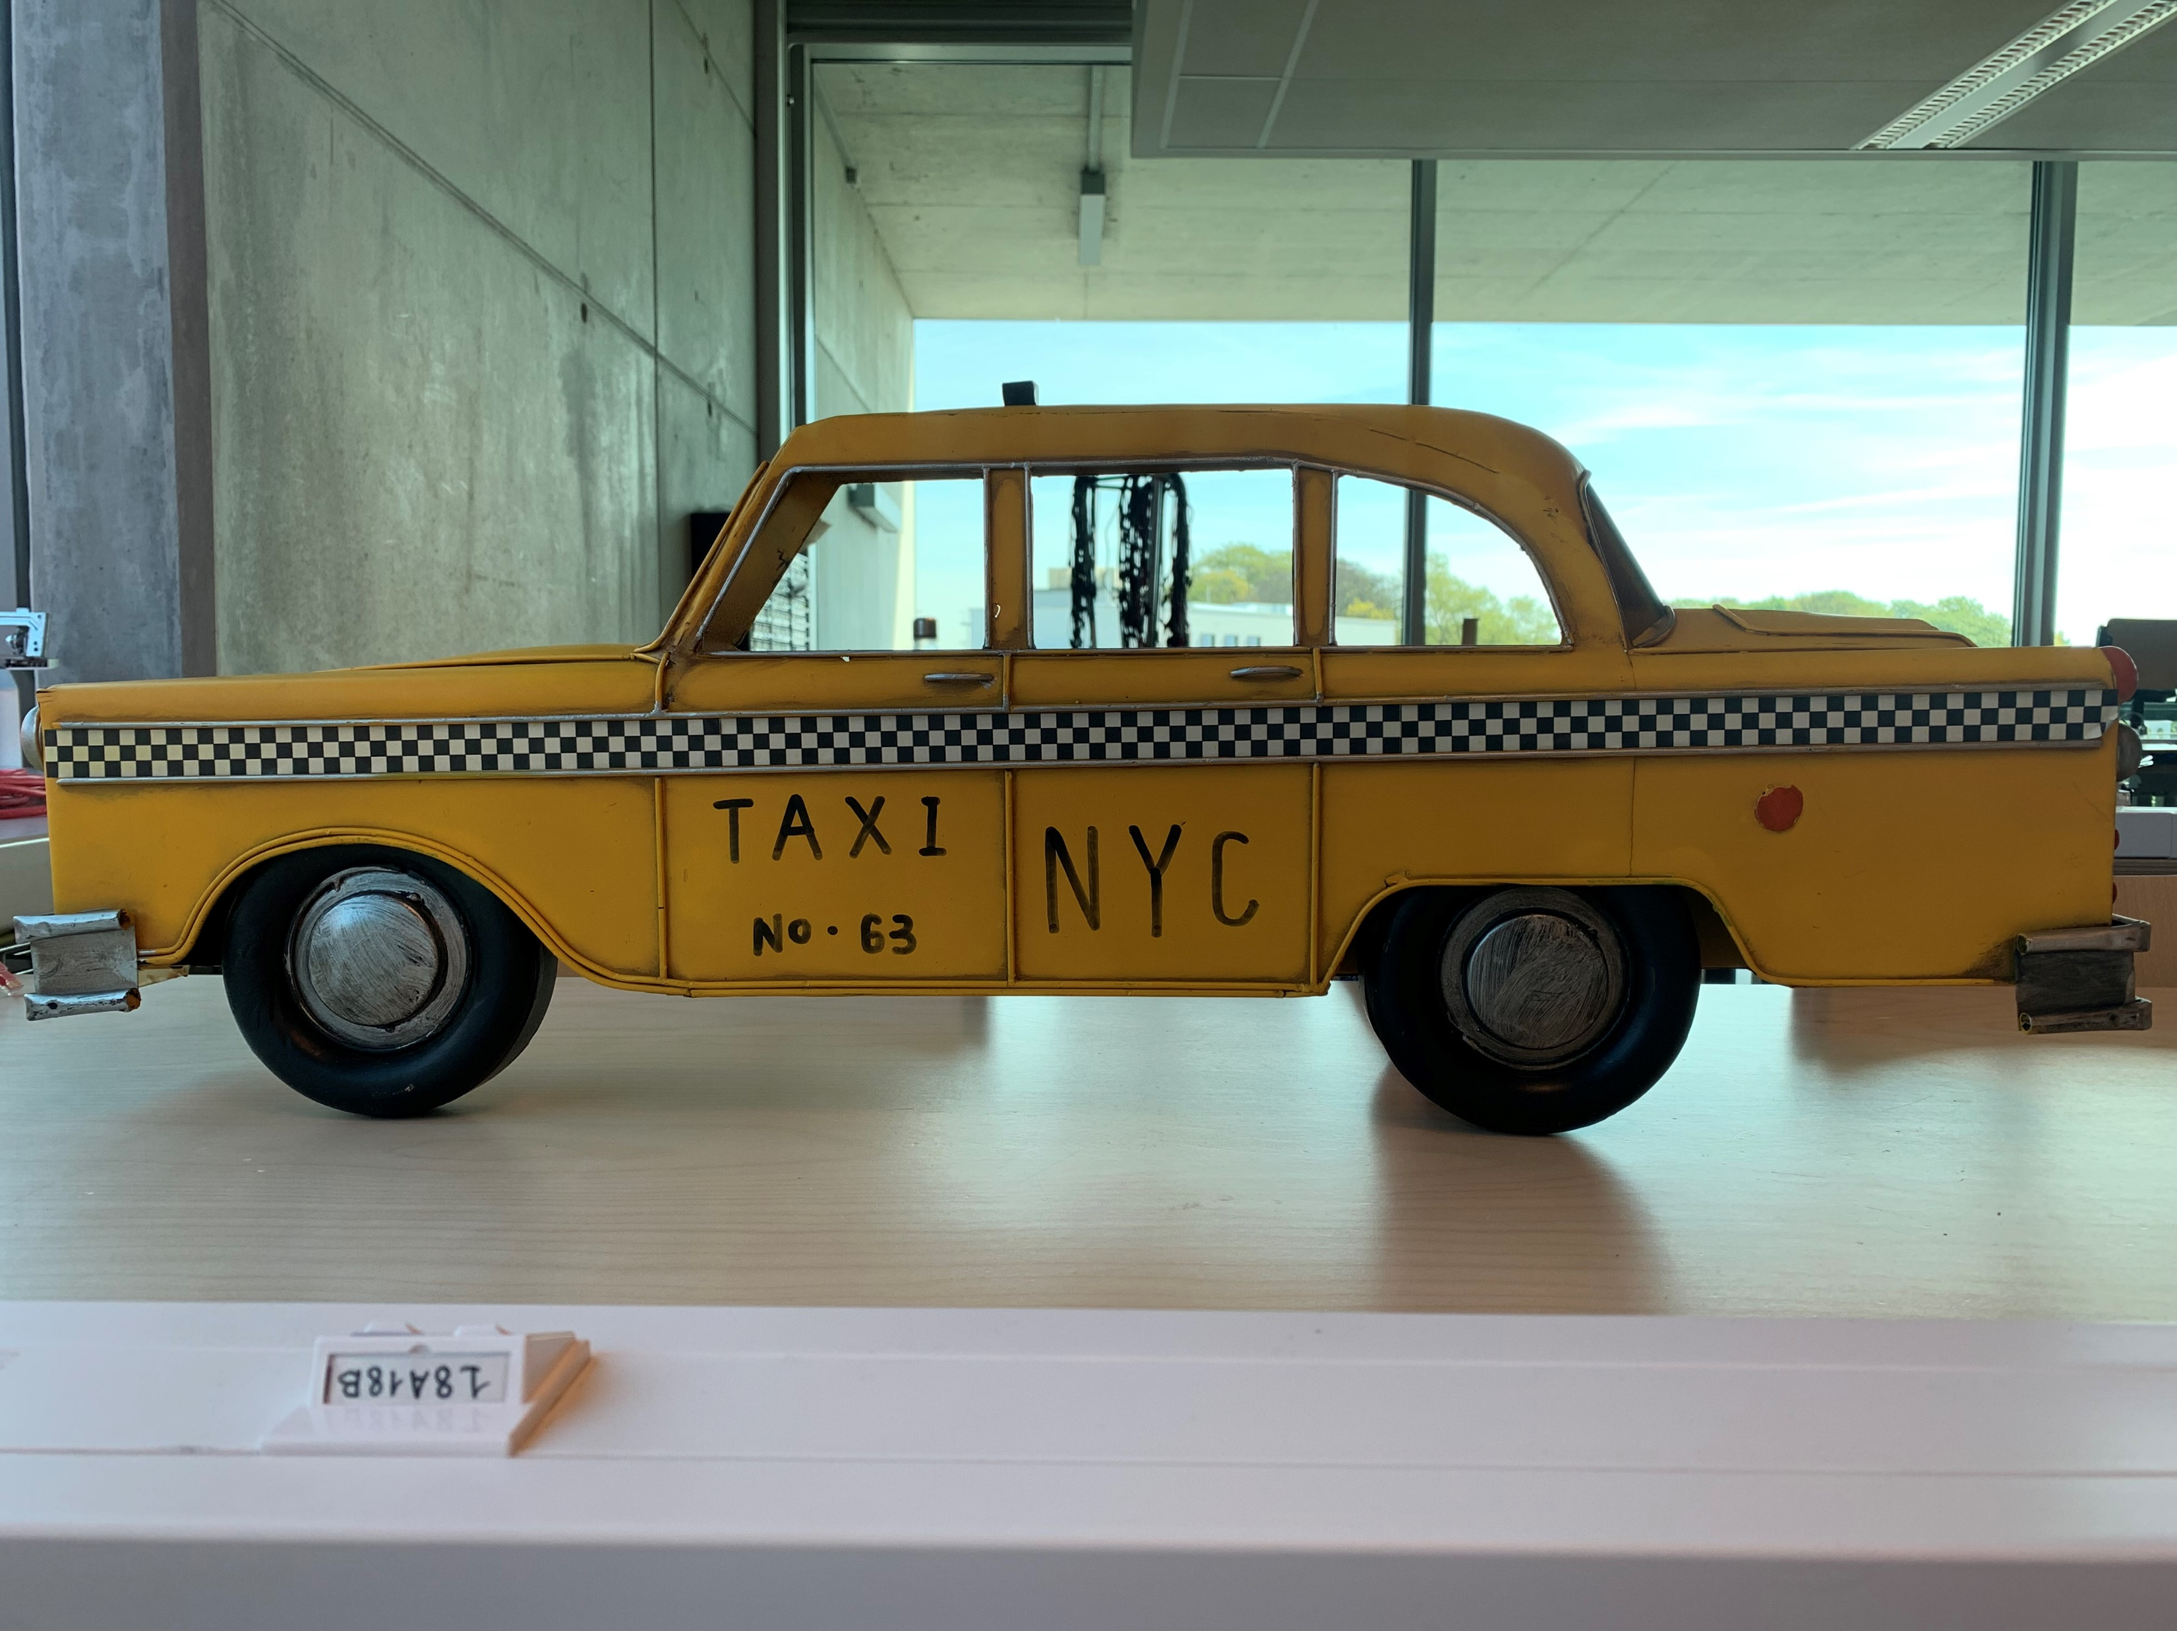
Prototype

Slide 12
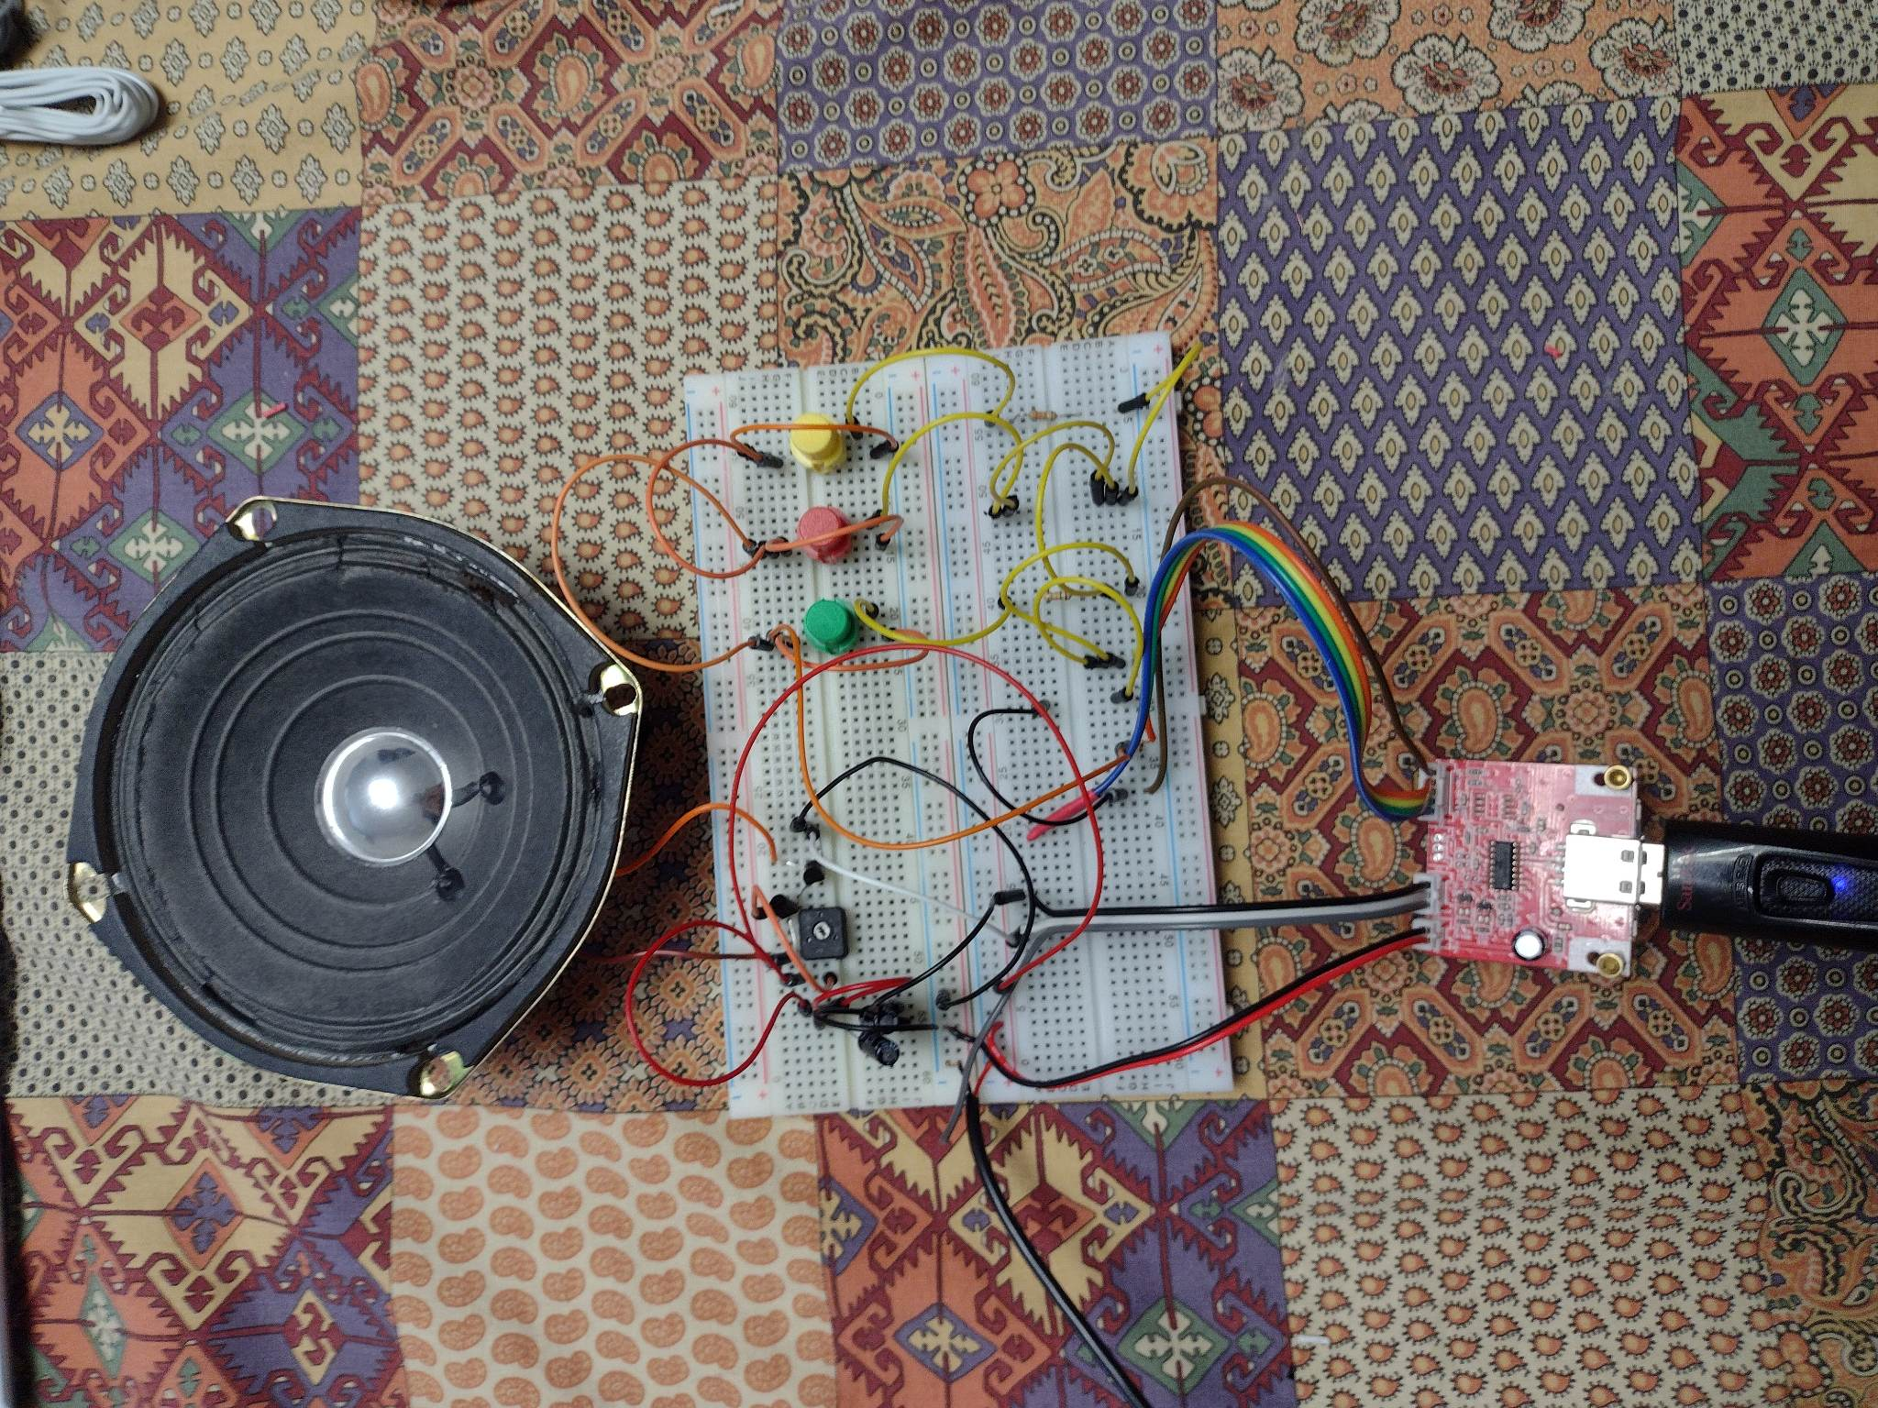
Prototype

Slide 13
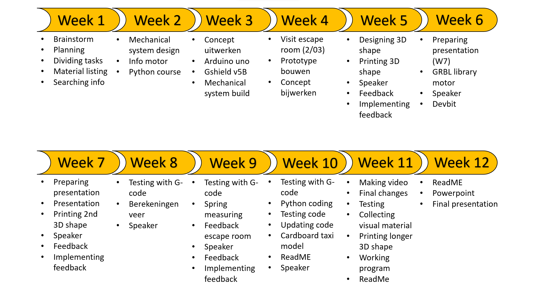
Planning

Slide 14
Final thought?

